Slide 1
Computational Physics (Lecture 7)
PHY4061

Slide 2
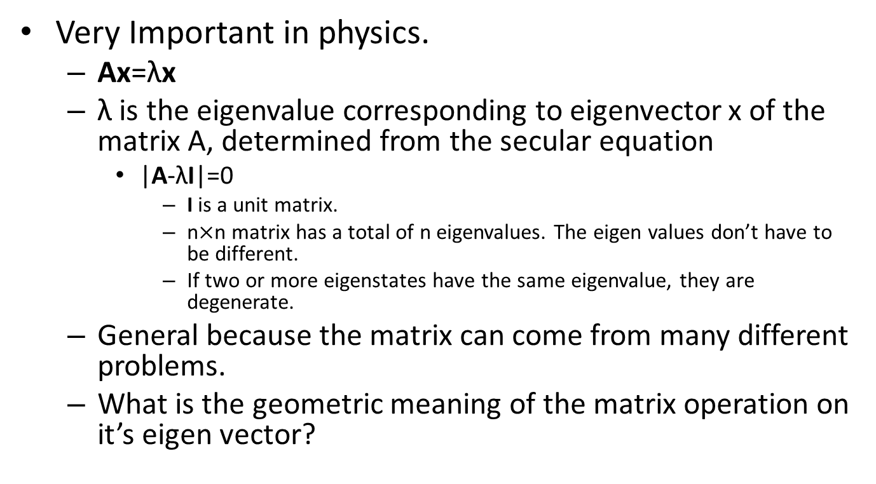
Eigen Value Problems
Very Important in physics.
Ax=λx
λ is the eigenvalue corresponding to eigenvector x of the matrix A, determined from the secular equation
|A-λI|=0
I is a unit matrix.
n$×$n matrix has a total of n eigenvalues. The eigen values don’t have to be different.
If two or more eigenstates have the same eigenvalue, they are degenerate.
General because the matrix can come from many different problems.
What is the geometric meaning of the matrix operation on it’s eigen vector?

Slide 3
An eigenvector v of a matrix B is a nonzero vector that does not rotate when B is applied to it.
Eigen vector v may change length or reverse its directions.
But it won’t turn sideways.
Iterative methods often depend on applying matrix on the vector over and over again.
If | λ |<1, B^{i}v= λ^{i}v will vanish
If | λ |>1, B^{i}v= λ^{i}v will go infinity

Slide 4
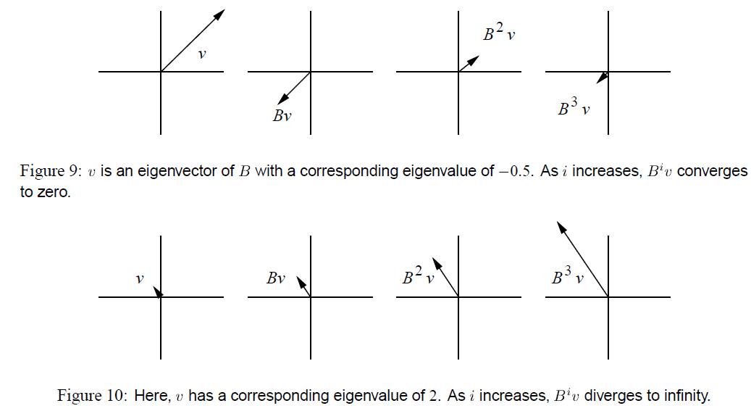

Slide 5
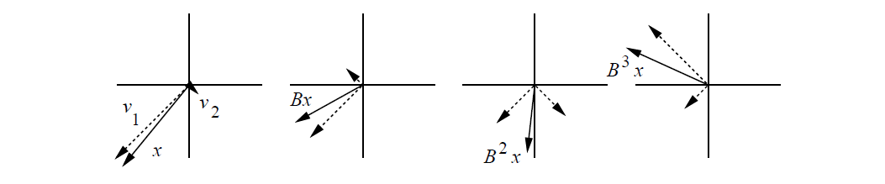

Slide 6
Matrix function
When a Matrix function operates on an eigen vector of the matrix, the matrix can be replaced by the corresponding eigen values:
f(A) x_{i} = f (λ_{i}) x_{i}

Slide 7
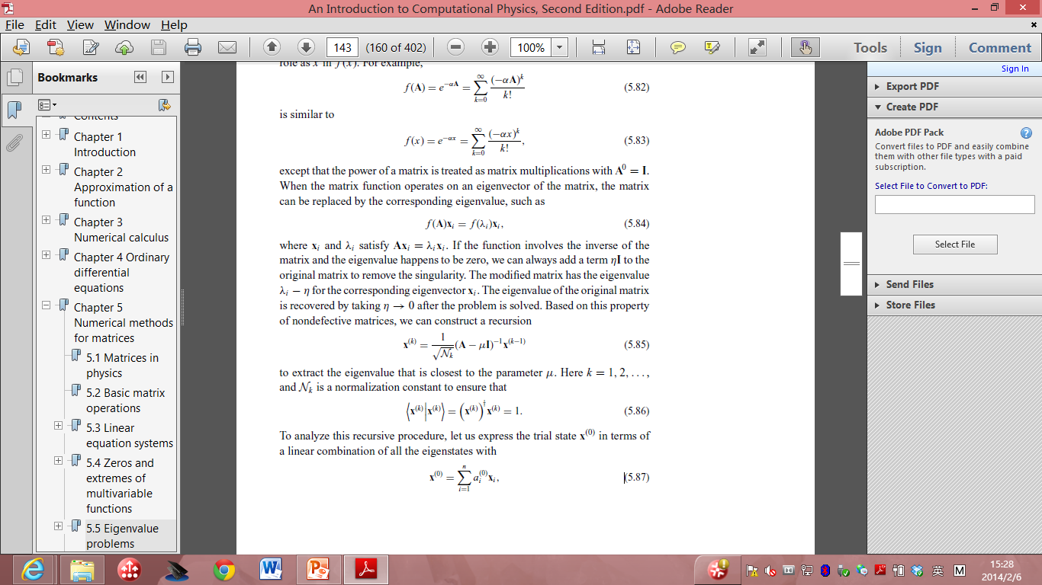
If the function involves the inverse of the matrix and the eigenvalue happens to be zero, we can always add a term ηI to the original matrix to remove the singularity.
The modified matrix has the eigenvalue λ_{i} − η for the corresponding eigenvector x_{i} .
The eigenvalue of the original matrix is recovered by taking η → 0 after the problem is solved.
Based on this property of nondefective matrices, we can construct a recursion: (Iterative method)
To extract the eigen value that is closest to the parameter μ, and N_{k} is a normalization constant to ensure
inverse iteration method

Slide 8
Eigen Values of a Hermitian matrix
In many physical problems, the matrix is Hermitian.
Complex conjugate of the transpose matrix equals the matrix itself.
Three important properties:
the eigenvalues of a Hermitian matrix are all real;
the eigenvectors of a Hermitian matrix can be made orthonormal;
a Hermitian matrix can be transformed into a diagonal matrix with the same set of eigenvalues under a similarity transformation of a unitary matrix that contains all its eigenvectors.
How do we implement complex matrix in our code?

Slide 9
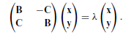
the eigenvalue problem of an n × n complex Hermitian matrix is equivalent to that of a 2n × 2n real symmetric matrix.
A = B + iC,
B and C are the real and imaginary parts of A,
If A is Hermitian,
B_{ij} = B_{ji}
C_{ij} = -C_{ji}
eigenvector z in a similar fashion, we have z = x + iy.
(B + iC)(x + iy) = λ(x + iy)
Therefore, we only need to solve the real symmetric eigen value problem if the matrix is Hermitian.

Slide 10
(1) use an orthogonal matrix to perform a similarity transformation of the real symmetric matrix into a real symmetric tridiagonal matrix;
a matrix that has nonzero elements only on the main diagonal, the first diagonal below this, and the first diagonal above the main diagonal.
(2) solve the eigenvalue problem of the resulting tridiagonal matrix.

Slide 11
The similarity transformation preserves the eigenvalues of the original matrix,
the eigenvectors are the columns or rows of the orthogonal matrix used in the transformation.
Householder method.
Givens method.
The most commonly used for tridiagonalizing
achieved with a total of n − 2 consecutive transformations, each operating on a row and a column of the matrix.

Slide 12
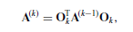
The transformations can be cast into a recursion:
for k = 1, 2, . . . , n − 2, where O_{k} is an orthogonal matrix that works on the row elements with i = k + 2, . . . , n of the kth column and the column elements with j = k + 2, . . . , n of the kth row. The recursion begins with A⁽⁰⁾ = A.
It is an O(N) algorithm.
Storage advantages.

Slide 13
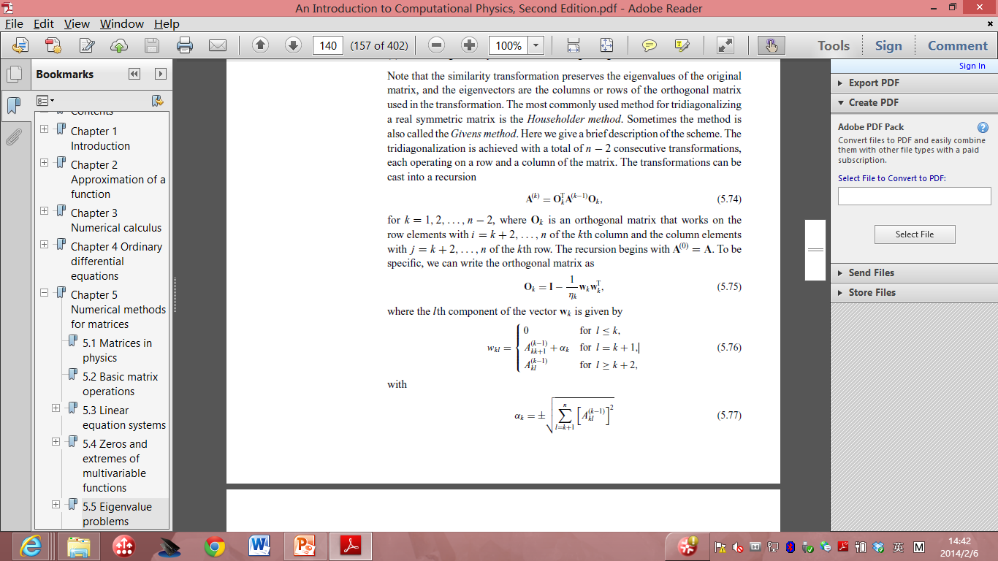
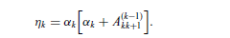
Here:
Where the lth component of the vector w_{k} is given by
with

Slide 14
Provided in standard math libraries. So we don’t have to reinvent the wheel here. Just take the code from most standard math libraries.
After we obtain the tridiagonalized matrix, the eigenvalues can be found using one of the root search routines available.
Note that the secular equation |A − λI| = 0 is equivalent to a polynomial equation p_{n}(λ) = 0.
Because of the simplicity of the symmetric tridiagonal matrix, the polynomial p_{n}(λ) can be generated recursively with:

Slide 15
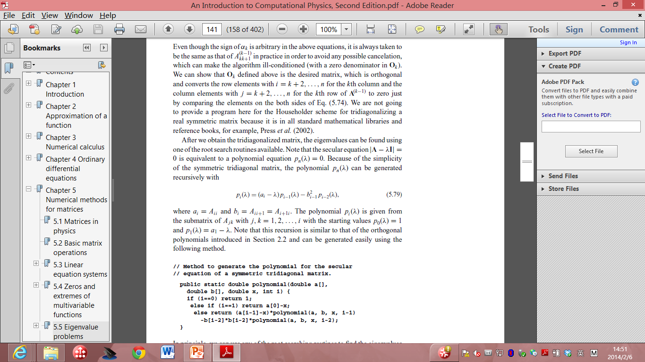
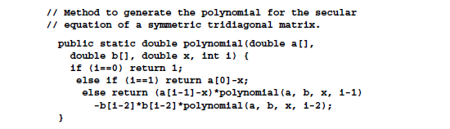
Where a_{i} = A_{ii} and b_{i} = A_{ii+1}=A_{i+1i}.
The polynomial is given from the submatrix of A_{jk} with j, k = 1,2…,i with the starting value p₀(λ) =1
And p₁(λ)=a_{1 - λ}.

Slide 16
In principle, we can use any of the root searching routines to find the eigenvalues from the secular equation
as soon as the polynomial is generated.
However, two properties associated with the zeros of p_{n}(λ) are useful in developing a fast and accurate routine to obtain the eigenvalues of a symmetric tridiagonal matrix.
Will not be covered in this lecture. If interested, you can read T. Pang book.

Slide 17
Continuation on inter-atomic potential

Slide 18
Unless we use the CP approach then we have to assume some form for the potential.
The assumption of a potential is a big approximation!
the potential energy surface is a function of 3N variables for N ions.
Symmetries such as translational degrees or rotational of freedom will only get rid of a few degrees of freedom.
What usually has to be done is to assume the many-body potential is a sum of pair potentials and perhaps three-body potentials etc.
This also assumes the molecule is rigid and weakly interacting with the environment so its internal electronic state does not couple with surrounding molecules.
A pair potential is a function of a single variable; there is no way it can exactly represent a 3N dimensional function.

Slide 19
So where do we get the pair potentials from?
The basic input is theoretical as we will discuss. The other input is empirical. Some sources of experimental data are:
atom-atom scattering in the gas phase can give direct information about the atom-atom potential. The scattering energy samples different regions of the interaction depending on the energy of the colliding atoms.

Slide 20
gas phase data, for example the virial coefficients and transport properties give integrals over the potential.
the low temperature thermodynamic properties. Most materials (except helium) form a solid at low temperature.
If the energy as a function of density is known, that gives fairly direct information about the depth of the potential well and its curvature.

Slide 21
high pressure information.
This samples the interaction at shorter distances than at lower pressures.
thermodynamic data,
such as melting temperature, the critical point and the triple point. This information is harder to use directly as it is many-body property. But one can use simulations to compute a phase diagram with a trial potential, then try to change the potential using perturbation theory to make the trial phase diagram agree with the actual phase diagram.

Slide 22
The difference between interpolation and extrapolation.
If experimental information is used to determine the potential, it will be good in a nearby region of phase space and for similar properties.
But that potential could be quite bad for unrelated properties or outside the region that has been fitted.
For example, if the potential has been determined using bulk properties, there is no reason to think it will be good to compute surface properties because the local environment on a surface is not as symmetrical as in the bulk.

Slide 23
Molecular Solids: The Noble Gases
These are the rare gases where the electronic shells are closed.
This means they are spherical atoms. They were the first systems to be simulated and the pair potentials work best for them!
At large distances one can understand the interactions by considering how two oscillators would interact, giving the r ⁻⁶ attraction where the coefficient is determined by the atomic polarizability.

Slide 24
On the other hand at short distances, the potentials are strongly repulsive because of the Pauli exclusion principle (electrons are fermions).
Lennard-Jones assumed a stronger inverse power, conveniently r ⁻¹². One should not think the LJ potential is anything more fundamental than this.

Slide 25
Even for Argon it is only accurate to 10% or so. And three-body potentials can be significant at the 10% level.
The potentials that are fit to bulk data are really effective potentials and could be somewhat different than the real 2-body potential that would be determined from gas-phase data because they include correction for three- and higher-body interactions. Hence the effective potentials can be dependent on density and less so on temperature.

Slide 27
Interatomic potential of Ionic crystals
Reference book chapter to read: Interatomic Potential Models for Ionic Materials, by Julian D. Gale, Handbook of Materials Modeling, pp 479-497.

Slide 28
Ionic materials:
in many key technological applications
solid state batteries
fuel cells,
nuclear waste immobilization
industrial heterogeneous catalysis
A long history of computer simulation of their structure and properties
to understand the materials science of these systems at the atomic level.

Slide 29
A binary compound is composed of two elements with very different electronegativities,
as is the case for oxides and halides in particular,
then it is convenient to regard it as being an ionic solid.
A result of charge transfer
from one element to the other,
the dominant binding force between particles is the Coulombic attraction between opposite charges.
Close-packed, dense structures that show no strong directionality in the bonding.

Slide 30
Imagining an ionic solid as being composed of cations and anions
Coulombic attraction between ions of opposite charge, with a corresponding repulsive force between those of like nature.
Because ions are arranged such that the closest neighbours are of opposite sign, this gives rise to a strong net attractive energy that will tend to contract the solid in order to lower the energy.

Slide 31
There must be a counterbalancing repulsive force.
This arises from the overlap of the electron densities of two ions, regardless of the sign of their charge, and has its origin in the Pauli repulsion between electrons.
Hence, we can write the breakdown of the two-body energy in general terms as:
U_{ij} = U_{Coulomb ij} + U_{repulsive ij}

Slide 32
U_{Coulomb ij} = q_{i}q_{j} /4πε₀r_{ij}
The electrostatic energy is actually the most difficult to evaluate.
Easy to write down that the electrostatic energy
the sum over all pairwise interactions, including all periodic images of the unit cell,
the complication arises because the sum must be truncated for actual computation!
Truncation problem.

Slide 33
Unfortunately, the summation is an example of a conditionally convergent series, i.e., the value of the sum depends on how the truncation is made.
The reason for this can be understood by considering the interactions of a single ion with all other ions within a given radius, r.
The convergence of the energy of interaction, U_{r tot}, is given by the number of interactions, N_{r}, multiplied by the magnitude of the interaction, U_{r}: U_{r tot} = Σ_{r} N_{r}U_{r}
One Question: Which goes up fast in ionic potential and why?

Slide 34
As r increases, the number of interactions rises in proportion to the surface area of the cut-off sphere: N_{r} ∝ 4πr ² .
However, the interaction itself only decreases as the inverse power of r
Consequently, the magnitude of interaction potentially increases as the cut-off radius is extended.
The fact that the magnitude converges in practice relies on the fact that there is cancelation between interactions with cations and anions.

Slide 35
It turns out that the electrostatic energy of a system actually depends on the macroscopic state of a crystal due to the long-ranged effect of Coulomb fields.
It is not purely a property of the bulk crystal, but also depends, in general, on the nature of the surfaces and of the crystal morphology.
To make it feasible to define an electrostatic energy that is useful for the simulation of ionic materials, it is conventional to impose two conditions on the Coulomb summation:

Slide 36
The sum of the charges within the system must be equal to zero
The total dipole moment of the system in all directions must also be equal to zero
If these conditions are satisfied, the electrostatic energy will always converge to the same value as the cut-off radius is incremented.

Slide 37
There is also the issue of how rapidly the sum converges,
since it is required that the calculation be fast for numerical evaluation.
By far the dominant approach to evaluating the electrostatic energy is through the use of the summation method due to Ewald
which aims to accelerate the convergence by partially transforming the expression into reciprocal space.
The details of the derivation can be found in Kittel’s textbook on solid state physics.
Here I just listed the basic idea of Ewald summation.
Do not worry, I do not require you to implement Eward summation.

Slide 38
In Ewald’s approach, a Gaussian charge distribution of equal magnitude, but opposite sign, is placed at the position of every ion in the crystal.
Because the charges cancel, all but for the contribution from the differing shape of the distribution,
the resulting electrostatic interaction between ions is now rapidly convergent when summed out in real space and converges to the energy U_{real}.
In order to recover the original electrostatic energy it is then necessary to compute two further terms.

Slide 39
Firstly, the interaction of the Gaussian charge distributions with each other must be subtracted.
Because of the smooth nature of the electrostatic potential arising from such a distribution, it is possible to efficiently evaluate this term, Urecip, by expanding the charge density in plane waves with the periodicity of the reciprocal lattice.
Again, the energy contribution is rapidly convergent with respect to the cut-off radius within reciprocal space.
Finally, there is the self-energy, Uself, that arises from the interaction of the Gaussian with itself.

Slide 40
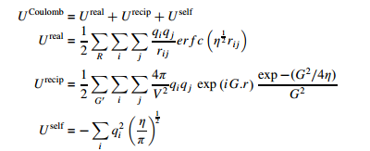
Mathematically, the Ewald sum is derived by a Laplace transform of the Coulomb energy and the final expressions are given below;

Slide 41
where R denotes a real space lattice vector, G represents a reciprocal lattice vector and η is a parameter that determines the width of the Gaussian charge distribution.
Note that the summation over reciprocal lattice vectors excludes the case when G = 0.

Slide 42
The key to rapid convergence of the Ewald sum is to choose the optimal value of η.
If the value is small, then the Gaussians are narrow and so the real space expression converges quickly, while the reciprocal space sum requires a more extensive summation due to the higher degree of curvature of the charge density.
Choosing a large value of η obviously leads to the inverse situation.

Slide 43
One approach to choosing the convergence parameter is to derive an expression for the total number of terms to be evaluated in real and reciprocal space for a given accuracy and then to find the stationary point where this quantity is at a minimum.
The choice of η_{opt} is then given by; η_{opt} = (Nπ³ /V) ^{1/3} where N is the number of particles within the unit cell.

Slide 44
While the electrostatic energy often accounts for the majority of the binding,
the non-Coulombic contributions are equally critical since they determine the position and shape of the energy minimum.
There must always be a short-ranged repulsive force between ions to counter the Coulomb attraction and therefore prevent the collapse of the solid.

Slide 45
Most work has followed the pioneering work in the field, as embodied in the Born– Meyer and Born–Lande equations for the lattice energy, by utilizing either an exponential or inverse power-law repulsive term.
This gives rise to two widely employed functional forms, namely the Buckingham potential; U_{short−ranged ij} = A_{ij} exp (− r_{ij} /ρ_{ij} ) − Cij / r⁶ _{ij} and that due to Lennard–Jones: U_{short−ranged ij} = B_{ij} /r^{m} _{ij} − C_{ij} /r ^{n} _{ij}

